Slide 1
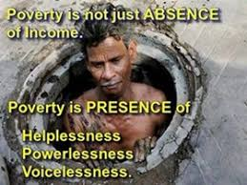
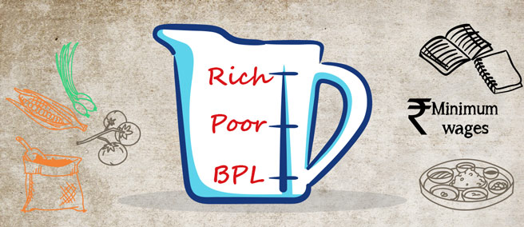
POVERTY IN INDIA

Slide 2
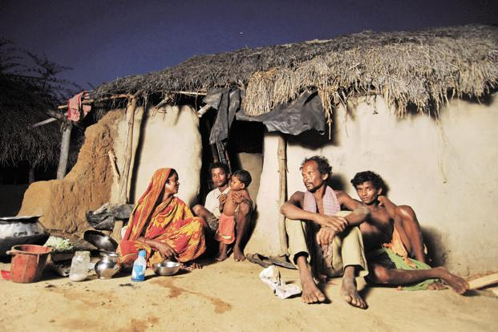
WHAT IS POVERTY???
Poverty is about not having enough money to meet basic needs including food, clothing and shelter. However, poverty is more, much more than just not having enough money.

Slide 3
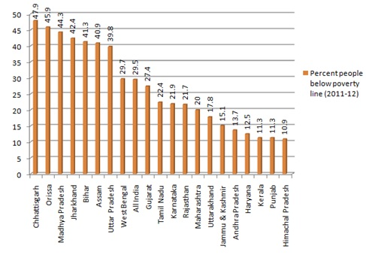
POVERTY LINE

Slide 4
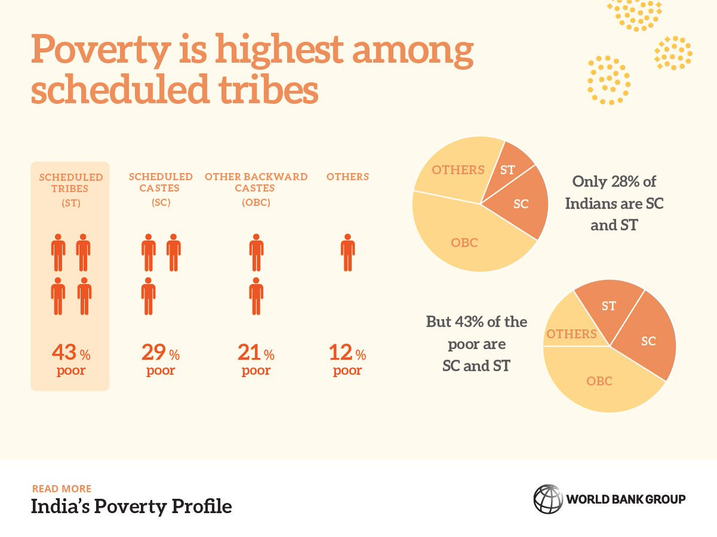
VULNERABLE GROUPS
Scheduled Tribes
Schedules Caste
Agricultural labour households
Casual labour households

Slide 5
WHY IS THIS HAPPENING????
Even though India’s economy is growing , their wealth distribution is uneven.
¼ of the nation’s population earns less than the government specified $0.40 a day.
Unemployment and underemployment.
Over-reliance on agriculture.
High population growth rate.
Illiteracy

Slide 6

HOW IT AFFECTS US!!!!
Reduced life expectancy
Increase in crime
Child anti-social behavior
Illegal land grabbing
Over utilization of natural resources
Hampers a child’s ability to grow and develop properly.

Slide 7
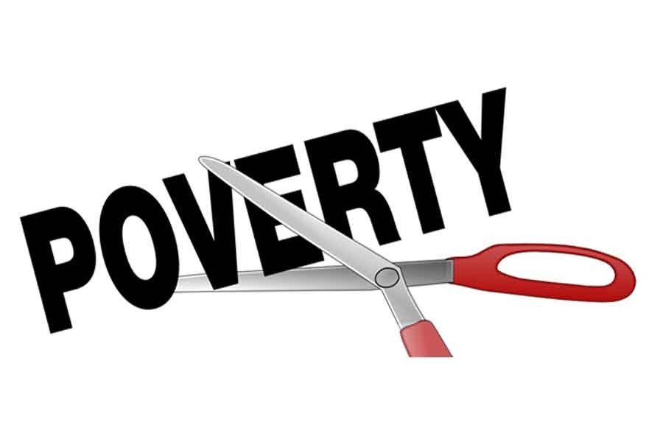
WHAT HAS BEEN DONE TO ERADICATE POVERTY????
Initiative of ration cards and ration shops.
Healthcare facilities made available and accessible to all.
Free education till class 5th.
Initiating welfare state and charities.
Employment schemes like NREGA.

Slide 8

OUR ROLE IN ERADICATING POVERTY!!!!
Educate the poor strata of the society.
Make generous donations.
Create jobs rather than looking for jobs.
Make people aware of govt. policies meant for their betterment.

Slide 9
CONCLUSION
Though a sharp bend is seen in poverty rate from 1981 to 2009 but poverty is still at large scale.
The govt. make schemes o eradicate poverty but instead the poor people have been eradicated.
In order for a bright future, we need to remove poverty completely and build a
POVERTY FREE NATION……

